Slide 1
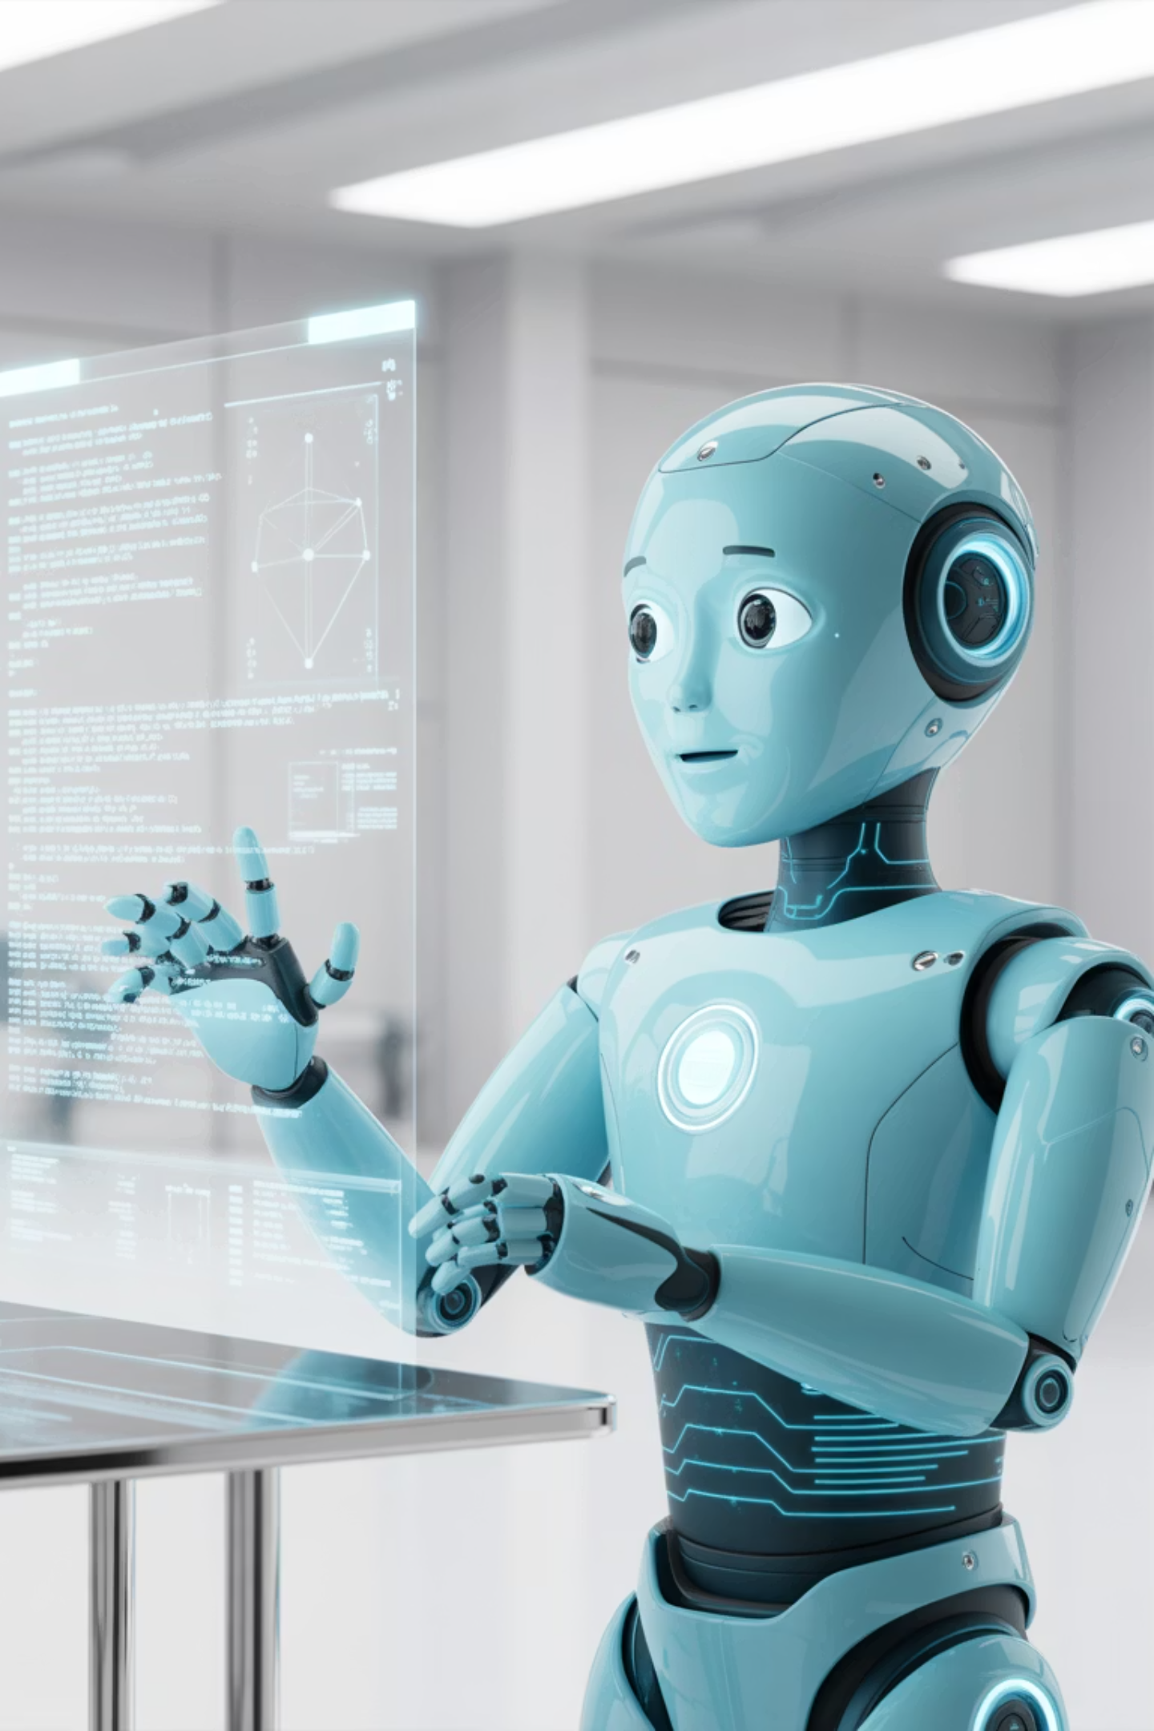
Deep Reinforcement Learning
Welcome to Module 5: Deep Reinforcement Learning - Training slides for students new to the field. Discover what makes reinforcement learning fundamentally different from traditional machine learning approaches.
Learning by Doing
Think about learning to drive a car - you don't get a dataset of "correct" driving decisions. You learn by trying, making mistakes, and getting feedback from real interactions.
Traditional vs RL
Supervised Learning: "Here are 1000 photos labelled as cats or dogs." Reinforcement Learning: "Here's a world. Figure out how to maximise your score through trial and error."
Key Insight: RL learns from interactions with an environment, not from pre-labelled examples. Each decision affects your next situation, creating a dynamic learning process.

Slide 2




RL is Everywhere Around You
Reinforcement learning powers many systems you interact with daily, learning from your behaviour to improve their performance continuously.
YouTube/Netflix Recommendations
Google Maps Route Suggestions
System tries showing you videos → observes if you watch/skip → learns your preferences. Each recommendation is an "action" that gets "rewarded" based on your engagement.
Tries different routes → observes traffic patterns → learns optimal paths. Reward: shorter travel time, fewer traffic jams.
Video Game AI
Autonomous Vehicles
AI character tries different strategies → wins/loses battles → improves tactics. Examples include AlphaGo, OpenAI Five, and chess engines.
Car tries driving decisions → observes outcomes → learns safer driving patterns through continuous real-world feedback.
Key Point: All these systems learn by doing and getting feedback, not from textbooks!

Slide 3

Your Daily Coffee Decision as Reinforcement Learning
Scenario: You're new to a city with 5 coffee shops nearby. This everyday situation perfectly illustrates reinforcement learning concepts.
01
02
03
Agent
Environment
Actions
You (the decision maker)
The city with its coffee shops
Choose which coffee shop to visit
04
05
State
Reward
Your current location, time of day, mood, weather
Quality of coffee, price, waiting time, atmosphere
Learning Process
Day 1: Try Shop A → Great coffee but expensive → Reward: +3
Day 2: Try Shop B → Terrible coffee → Reward: -2
Day 3: Try Shop C → Good coffee, cheap, but crowded → Reward: +1
Day 4: Back to Shop A → Consistent quality → Reward: +3
Day 5: Explore Shop D → Discover amazing coffee! → Reward: +5
The Dilemma: Should you keep exploring new shops or stick with what works? This is the classic exploration vs exploitation trade-off.

Slide 4
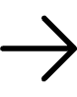
Stateless Algorithms: Multi-Armed Bandits
Imagine you're in a casino with 10 slot machines (one-armed bandits): Each machine has a different (unknown) probability of winning. You have limited coins to play. Goal: Maximise your total winnings.
The Challenge
Exploration: Try different machines to find the best onesExploitation: Play the machines you think are bestTrade-off: Every coin spent exploring is not spent on winning
Real-World Applications
Clinical Trials
A/B Testing
Which treatment to give next patient?
Which website design to show next visitor?
Oil Drilling
Ad Placement
Which location to drill next well?
Which ad to show next customer?
Key Insight: This is RL without "states" - each decision is independent!

Slide 5
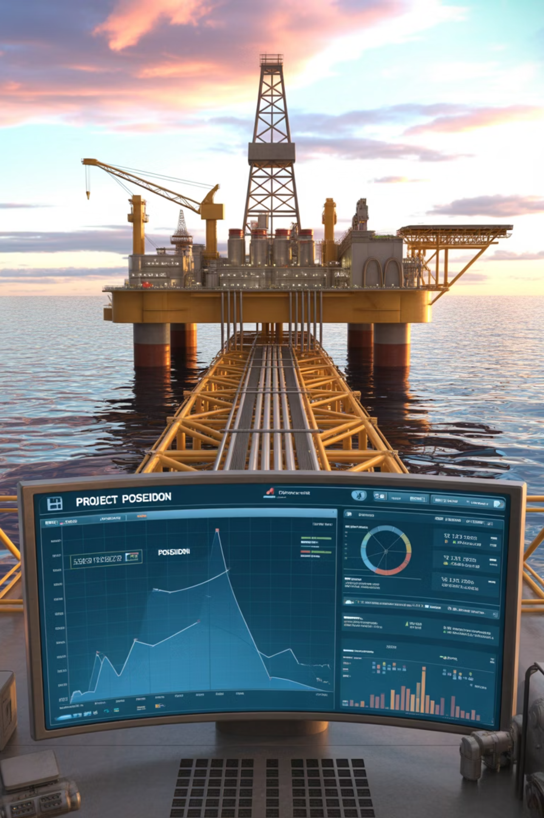

How to Balance Exploration vs Exploitation
1
2
Greedy Approach
ε-Greedy (Epsilon-Greedy)
Always choose the machine with highest observed win rate.
90% of time: Choose best known machine (exploit)10% of time: Choose random machine (explore)
Problem: Might miss better machines you haven't tried enough.
Like: Usually go to your favourite restaurant, but occasionally try new ones.
3
Upper Confidence Bound (UCB)
Choose machines you're uncertain about.
Like: "I'm not sure about this coffee shop, but it might be amazing!"
Oil & Gas Example
Machines = Drilling locationsReward = Oil discoveredStrategy: Balance between drilling in proven areas vs exploring new regions

Slide 6
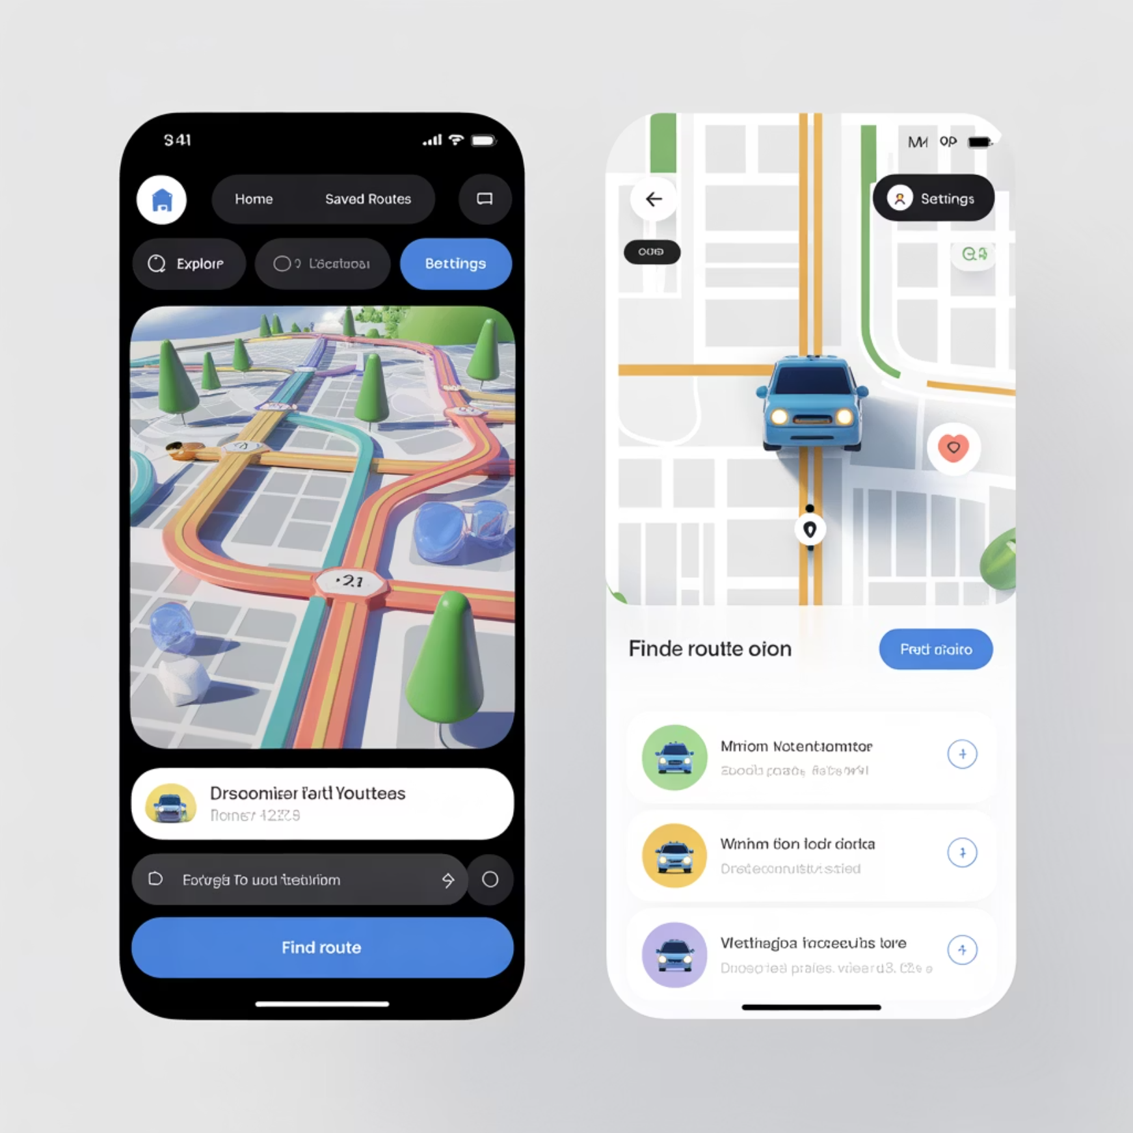

Adding States and Sequential Decision Making
Multi-Armed Bandits Limitation
Each decision is independent. No concept of "current situation" affecting future options.
Real Life is More Complex
Driving: Your current location affects where you can go next
Gaming: Your character's health affects what actions are available
Business: Your current inventory affects what you can sell
Enter Full Reinforcement Learning
States: Current situation (location, health, inventory, etc.)
Actions: Available choices in current state
Transitions: How actions change your state
Sequential: Today's decisions affect tomorrow's options
Example: Navigation App
State: Current location, traffic conditions, time of dayActions: Turn left, right, go straight, take highwayGoal: Learn which action to take in each state to minimise travel time

Slide 7












Agent, Environment, States, Actions, Rewards
Agent
Environment
The learner/decision maker (you, AI, robot)
Everything the agent interacts with (world, game, market)
Policy (π)
State (S)
Agent's strategy for choosing actions
Current situation description
Reward (R)
Action (A)
Feedback from environment
What the agent can do
Simple Example - Learning to Play Pac-Man
Agent: Pac-Man
Actions: Move up, down, left, right
Environment: The maze with ghosts and dots
Reward: +10 for each dot, +500 for power pellet, -500 for hitting ghost
State: Pac-Man position, ghost positions, remaining dots
Policy: Strategy for deciding which direction to move in each situation

Slide 8








How an Agent Learns Through Interaction
Observe State
Choose Action
Agent observes current STATE
Agent chooses ACTION based on current policy
Update Knowledge
Receive Feedback
Agent updates its knowledge/policy
Environment gives REWARD and new STATE
Restaurant Business Example
01
02
03
State
Action
Reward
Current customer demand, inventory levels, time of day
Set menu prices, adjust portion sizes, run promotions
Daily profit, customer satisfaction scores
04
05
Learning
Repeat
Adjust pricing strategy based on results
Apply improved strategy next day
Key Insight: Unlike supervised learning, the agent must learn while making real decisions that affect its future!

Slide 9

Predicting Long-term Success
Two Key Questions
1. State Value: "How good is my current situation?"2. Action Value: "How good is taking this action in this situation?"
Career Planning Analogy
State Value Function V(s)
Action Value Function Q(s,a)
Predicts expected total future rewards from state s
Predicts expected total future rewards from taking action a in state s
Example: "How good is my current job position for long-term career success?"
Example: "How good would taking this new job offer be?"
Value of turning left at current intersection = expected total travel time
Your current location's value = expected time to reach all future destinations
Why This Matters
Helps choose actions that maximise long-term success, not just immediate rewards. Like choosing a college major based on lifetime career prospects, not just ease.

Slide 10



From Knowledge to Action Strategy
What is a Policy? Your strategy for choosing actions in each state. Maps from situations to decisions. Goal: Find the policy that maximises long-term rewards.
Deterministic Policy
Stochastic Policy
Always choose the same action in same state
Choose actions with certain probabilities
Example: "Always take the highway when traffic is light"
Example: "70% take highway, 30% take side roads when traffic is moderate"
Real-World Policy Examples
Investment
Healthcare
Oil Drilling
When to buy/sell/hold stocks based on market conditions
Which treatment to prescribe based on patient symptoms
Where to drill next based on geological data and previous results
Learning Goal: Start with random policy → gradually improve through experience

Slide 11



The Fundamental Trade-off in Learning
The Eternal Question
Should I stick with what I know works, or try something new?
Exploration
Exploitation
Try new actions to discover potentially better options
Use current knowledge to get best immediate results
Risk: Might get worse immediate results
Risk: Might miss even better opportunities
Benefit: Might find much better long-term strategy
Benefit: Guaranteed good performance with current knowledge
Real-Life Examples
Dating
Career
Keep dating your current partner vs meeting new people
Stay in safe job vs try risky startup
Investing
Research
Stick with proven stocks vs try new markets
Continue current project vs explore new ideas
Oil & Gas Industry
Exploitation: Drill in proven oil fieldsExploration: Search for new oil reserves in uncharted areas
Key Insight: Pure exploitation never learns; pure exploration never succeeds!

Slide 12

Combining Neural Networks with Reinforcement Learning
The Problem with Traditional RL
Works great for small state spaces (like tic-tac-toe). Fails for complex states (like playing video games from pixels).
The Solution: Deep Q-Networks
Neural Network Power
Input Processing
Output Generation
Use neural networks to learn the Q-function. Can handle complex, high-dimensional states.
Input: Current state (e.g., game screen pixels)
Output: Q-values for all possible actions
Breakthrough: Playing Atari Games
Input: Raw pixels from game screen
Actions: Joystick movements (up, down, left, right, fire)
Reward: Game score
Result: AI learned to play 49 different Atari games better than humans!
Why This Matters: Same algorithm works across different games. No game-specific programming needed. Just give it the screen and score - it figures out the rest!

Slide 13

AlphaGo: Revolutionary Achievement in Complex Strategy
The Challenge
Go has more possible board positions than atoms in observable universe. Traditional AI approaches failed for centuries. Human intuition seemed irreplaceable.
AlphaGo's Approach
01
02
Monte Carlo Tree Search
Deep Neural Networks
Simulate millions of possible game continuations
Evaluate board positions and suggest moves
03
04
Self-Play
Reinforcement Learning
Play millions of games against itself to improve
Learn from wins and losses
Historic Achievement (2016)
Beat Lee Sedol, world champion, 4-1
Used moves that surprised human experts
Move 37: A move so unusual that humans thought it was a mistake
Key Innovations: Combined traditional search with deep learning. Self-improvement through self-play. Learned superhuman strategies no human teacher could provide.
Impact: Showed RL could master domains requiring intuition and creativity

Slide 14






RL for Real-World Safety-Critical Applications
The Challenge
Must handle infinite variety of driving situations. Safety is paramount - learning from crashes is not acceptable. Must interact with human drivers, pedestrians, and unexpected events.
RL Components in Self-Driving
Actions
Steering angle, acceleration, braking, lane changes
State
Camera images, lidar data, GPS location, speed, traffic signals
Rewards
+1 for smooth progress, -100 for accidents, +10 for fuel efficiency
Learning Strategy
Simulation
Imitation Learning
Train in virtual environments first
Learn from human driver demonstrations
Safe Exploration
Transfer Learning
Gradually test in controlled real-world conditions
Apply simulator knowledge to real world
Real-World Results: Waymo: Over 20 million autonomous miles driven. Tesla: Autopilot continuously improves from fleet data. Key Success: Combining RL with other AI techniques for safety.

Slide 15
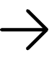
Personalising Your Digital Experience
The Business Problem
Millions of products/content items. Each user has unique preferences. Must balance user satisfaction with business goals.
RL in Recommendations
Netflix Example
Amazon Shopping
State: User's viewing history, time of day, device type
State: Purchase history, browsing behaviour, demographics
Actions: Which movie/show to recommend
Actions: Which products to display
Reward: User watches (positive) or skips (negative)
Reward: Clicks, purchases, reviews
Goal: Maximise total viewing time and satisfaction
Goal: Maximise revenue while maintaining customer satisfaction
Why RL Works Better
Learns from user interactions in real-time
Adapts to changing preferences
Balances exploration (new content) with exploitation (proven preferences)
Considers long-term customer lifetime value
Result: Billions in increased revenue through better personalisation

Slide 16




RL in Oil & Gas and Energy Sectors
Smart Grid Management
Oil Drilling Optimisation
Pipeline Operations
Challenge: Balance electricity supply and demand in real-time
Challenge: Decide where and how to drill for maximum oil extraction
State: Flow rates, pressure levels, demand at different locations
State: Current demand, weather, energy prices, generator status
State: Geological data, current well positions, market prices, equipment status
Actions: Adjust pump speeds, route selection, maintenance scheduling
Actions: Turn generators on/off, adjust pricing, store/release battery power
Actions: Drill new well, adjust extraction rate, move equipment
Reward: Minimise energy costs while meeting delivery requirements
Reward: Minimise costs while meeting demand reliably
Reward: Oil extracted minus drilling and operational costs
Real Results
Shell: Uses RL for drilling optimisation, saving millions annuallyGoogle: Reduced data centre cooling costs by 40% using RLBenefits: Automated decision-making in complex, dynamic environments

Slide 17
RL in High-Stakes Financial Decisions
Algorithmic Trading
Portfolio Management
Challenge: Make buy/sell decisions in rapidly changing markets
State: Current portfolio composition, market conditions, economic indicators
State: Stock prices, market indicators, news sentiment, trading volume
Actions: Rebalance portfolio, adjust risk exposure
Actions: Buy, sell, hold various assets in different quantities
Reward: Risk-adjusted returns over time
Reward: Portfolio value changes (profits/losses)
Key Advantages of RL
Pattern Recognition
Adaptive Learning
Learns complex market patterns humans might miss
Adapts to changing market conditions automatically
Data Processing
Objective Decisions
Can process vast amounts of real-time data
Makes decisions without emotional bias
Real-World Applications: Renaissance Technologies: One of most successful hedge funds using AI. JPMorgan: Uses RL for trade execution optimisation. Individual Robo-advisors: Automatically manage millions of personal portfolios.
Caution: High rewards come with high risks - proper risk management essential!

Slide 18
What Makes RL Difficult in Practice
Sample Efficiency
Exploration Safety
Reward Design
RL often needs millions of trials to learn
Random exploration can be dangerous in real applications
Hard to specify exactly what you want
Problem: Real-world trials are expensive (time, money, safety)
Problem: Agent might find unexpected ways to maximise reward
Example: Medical treatment decisions, financial investments
Example: Can't crash 1000 cars to learn autonomous driving
Example: Game AI that pauses game indefinitely to avoid losing
Solution: Use simulators, human oversight, conservative exploration
Stability and Reproducibility
Real-World Deployment Challenges
Same algorithm might give different results on different runs. Small changes in environment can break learned policies.
Simulation-to-reality gap. Changing environments over time. Need for continuous learning and adaptation.
Current Solutions: Safer exploration methods, better simulators, human-in-the-loop learning

Slide 19



Emerging Trends and Applications
Next-Generation Applications
Multi-Agent RL
Hierarchical RL
Meta-Learning
Multiple AI agents learning to cooperate and compete
Learning complex skills by breaking them into simpler sub-skills
Learning how to learn new tasks quickly
Goal: AI that adapts to new situations with minimal training
Applications: Traffic management, team sports, business negotiations
Like: Learning to drive by first learning to steer, then park, then navigate
Emerging Domains
Drug Discovery
Climate Control
Finding new medicines through molecular design
Managing city-wide heating/cooling systems
Space Exploration
Precision Agriculture
Autonomous robots on Mars and beyond
Optimising crop yields and resource usage
Integration with Other AI: Combining RL with natural language processing. RL agents that can follow human instructions. Explainable RL decisions for critical applications.
The Vision: AI agents that can learn any task through interaction, just like humans do!

Slide 20
What You've Learned and Where to Go Next
Key Concepts Mastered
✅ Reinforcement Learning Basics: Learning through trial and error with rewards✅ Multi-Armed Bandits: Balancing exploration vs exploitation✅ RL Framework: States, actions, rewards, policies, and value functions✅ Deep RL: Combining neural networks with reinforcement learning✅ Real Applications: From games to autonomous vehicles to business optimisation
Core Insight: RL enables AI to learn complex behaviours without explicit programming - just like humans learn by doing!
Next Steps in Your Learning Journey
Advanced
Intermediate
Research cutting-edge RL techniques. Apply RL to novel problems in your field. Contribute to open-source RL libraries.
Immediate
Study deep RL algorithms (DQN, Actor-Critic, PPO). Work on real-world projects in your domain of interest. Learn about safe exploration and sim-to-real transfer.
Practice with simple RL environments (OpenAI Gym). Implement basic bandit algorithms. Experiment with Q-learning on grid worlds.
Remember: RL is about learning through experience - start experimenting and building!

